Slide 1
PROJECT TITLE:- Fault Diagnosis in Drive End Bearings using CNN-based Machine Learning
PIP104 PROFESSIONAL PRACTICE-II
VIVA-VOCE
Batch Number: CAI-G32
Roll Number | Student Name
20201CAI0168 | Sinchana N Raj
20201CAI0171 | Vinutha K
20201CAI0186 | Geethanjali TS
Under the Supervision of,
Dr. Alamelu Mangai Jothidurai
Associate Professor
School of Computer Science & Engineering Presidency University

Slide 2
Introduction
The introduction underscores the critical issue of machinery failure in various sectors, highlighting the economic and operational implications. It emphasizes the importance of early detection of faults, particularly in rotating machines where roller bearings play a vital role. The discussion introduces components in rotating machines, with a specific focus on anomaly detection as a method to predict and prevent machinery failures. Traditional methods for identifying bearing faults are acknowledged, but their limitations in accuracy and adaptability are noted. The narrative transitions to the role of deep learning, particularly Convolutional Neural Networks (CNNs) and Recurrent Neural Networks (RNNs), in fault detection, leveraging spectrogram data for comprehensive visualization of signal frequency distribution. The project's objective is framed as an exploration of fault diagnosis methodologies using sensor data from rotating machinery, specifically sourced from the Case Western Reserve University (CWRU) Bearing Data Center.

Slide 3
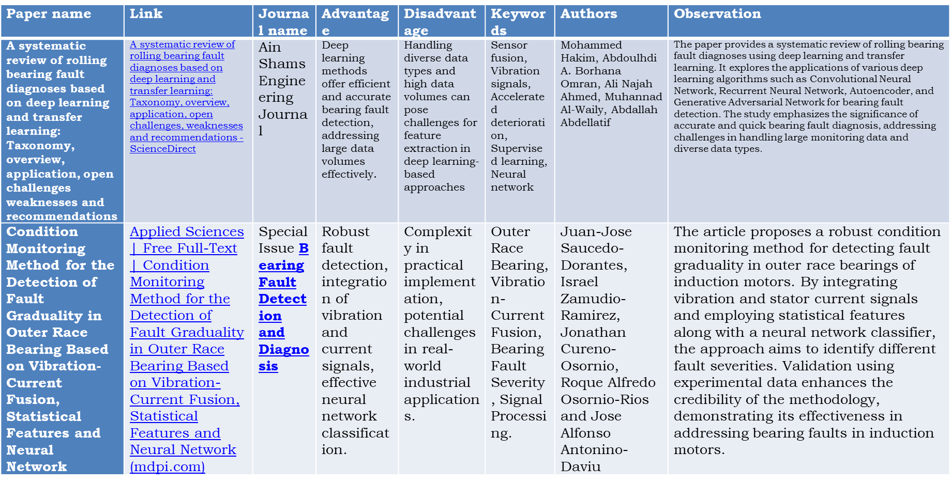
Literature Review

Slide 4
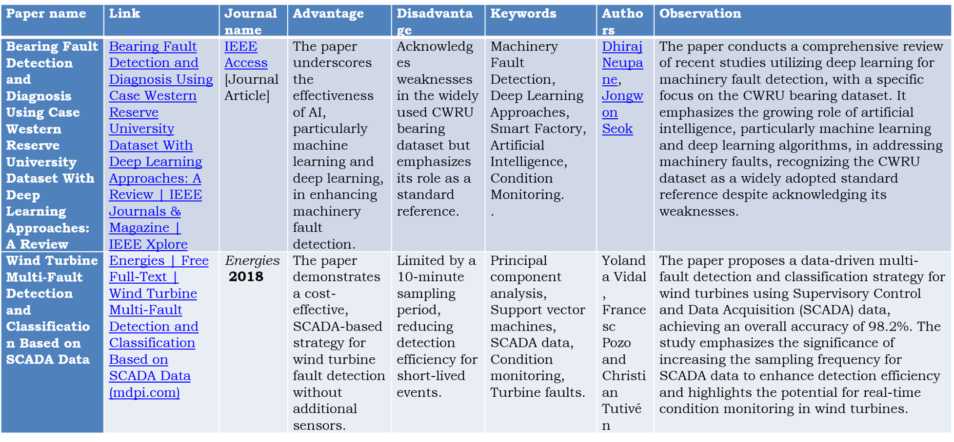
Literature Review

Slide 5
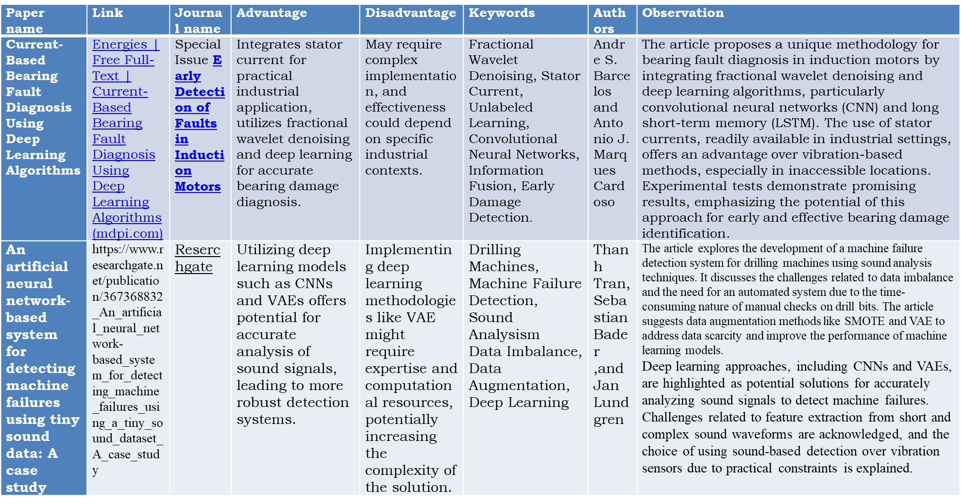
Literature Review

Slide 6
Research Gaps Identified
The research identified critical gaps in fault diagnosis within industrial systems, emphasizing the need for comprehensive solutions to challenges such as limited labeled data, complex fault patterns, interpretability issues in deep learning models, and integration hurdles with maintenance practices. Notably, the study highlighted promising approaches like data augmentation, hybrid models, explainable AI techniques, continuous learning strategies, and context-aware fault diagnosis. Leveraging the Case Western Reserve University (CWRU) Bearing Dataset, the research emphasized the significance of exploring fault detection capabilities under various motor power conditions, contributing to predictive maintenance. Understanding fault types in rotating machinery is crucial, and the utilization of vibration data from datasets like CWRU aids in developing machine learning models for proactive fault recognition and classification, facilitating effective predictive maintenance strategies.

Slide 7
Proposed Methodology
This methodology is a step-by-step process for detecting faults in roller bearings using vibration data.
Explore Data Load and Prepare Data Understand the Data Save and Normalize Data
Build a Specialized Model (CNN) Train and Test the Model Evaluate Performance Document and Improve

Slide 8
Objectives
The project’s goal is to create a smart system that can detect problems in roller bearings early on by analyzing vibration data.
Understand the Data Get the Data Ready Spot Patterns Build a Special Computer Model (CNN)
Teach the Model Check How Well It Work Keep Records and Show Results

Slide 9
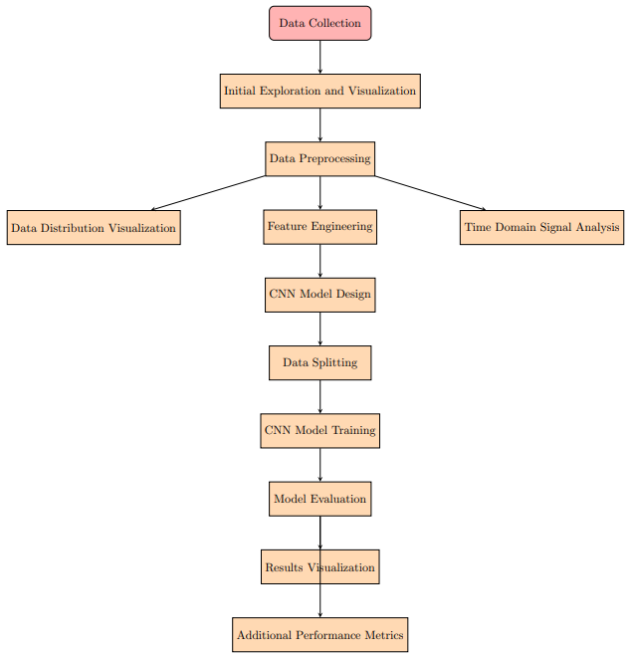
System Design & Implementation

Slide 10
System Design & Implementation
Code 1: Data exploration, Processing, and Visualization
Data Prep File Handling Visualization Batch Processing
Concatenation and Saving
Code 2: CNN-based Fault Diagnosis Model
Machine Learning Model (CNN) Data Loading and Processing Model Building Training the Model
Predictions Evaluation Metrics Suggestions and Customization:

Slide 11
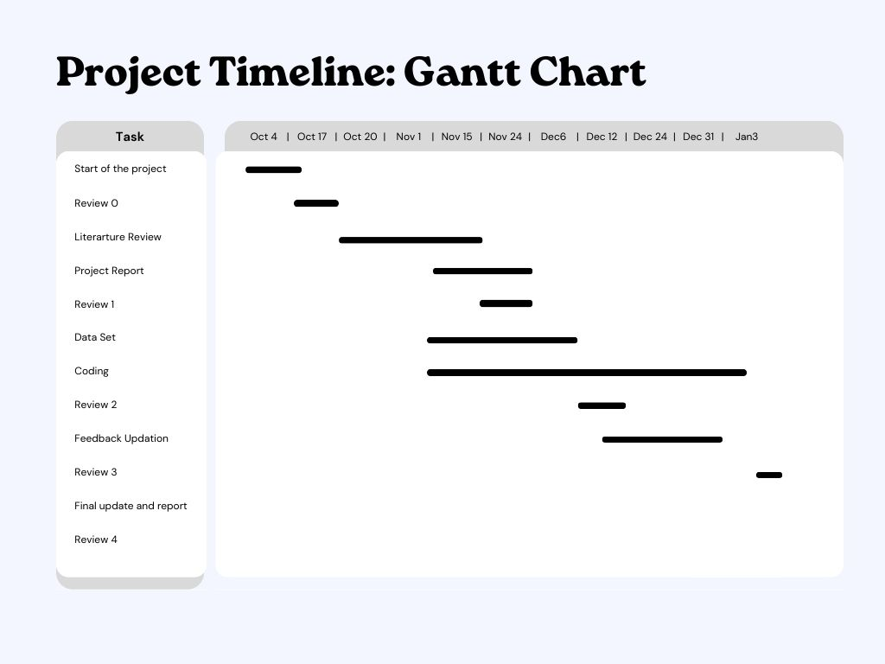
Timeline of Project

Slide 12
Outcomes / Results Obtained
A smart system, based on Convolutional Neural Networks (CNN), has been implemented for diagnosing faults in machinery, specifically using the CWRU 48k Drive End Bearing Fault Dataset.
Revolutionizing Fault Diagnosis Reducing Incidents and Improving Health Real-time Insights
Optimizing Maintenance Strategies Lowering Associated Costs Educational Tool
Empowering Communities Reducing Unplanned Downtime

Slide 13
Conclusion
In conclusion, this project achieved its objective of developing a fault diagnosis system for drive end bearings using CNN-based machine learning techniques, focusing on the CWRU dataset. The two main phases encompassed effective data preprocessing, including organization and visualization, and the successful implementation of a CNN architecture for fault classification. Results and performance metrics, such as accuracy, precision, recall, and F1 score, highlighted the model's promising performance in differentiating between various fault types. Visualization of results enhanced the model's interpretability, while the project's impact lies in contributing to predictive maintenance. Future work may involve model refinement, exploration of alternative architectures, and collaboration with domain experts for broader applicability. Overall, the project advances the goal of enhancing machinery reliability through intelligent fault detection.

Slide 14
References
[1] Mohammed Hakim, Abdoulhdi A.Borhana Omran, Ali Najah Ahmed, Muhannad Al-Waily, Abdallah Abdellatif(2023) .A systematic review of rolling bearing fault diagnoses based on deep learning and transfer learning: Taxonomy, overview, application, open challenges weaknesses and recommendations. Ain Shams Engineering Journal, volume 14, Issue 4.
https://doi.org/10.1016/j.asej.2022.101945
[2] Thanh Tran, Sebastian Bader, and Jan Lundgren(2022). An artificial neural network-based system for detecting machine failures using a tiny sound dataset: A case study. IEEE International Symposium on Multimedia (ISM)
https://doi.org/10.1109/ISM55400.2022.00036
[3] Lijun Zhang, Yuejian Zhang, Guangfeng Li (2023). Fault-Diagnosis Method for Rotating Machinery Based on SVMD Entropy and Machine Learning. MDIP, 16(6), 304.
https://www.mdpi.com/1999-4893/16/6/304

Slide 15
References
[4] Xiaoran Zhang, Kantilal Pitambar Rane, Ismail Kakaravada, and Mohammad Shabaz(2021). Research on vibration monitoring and fault diagnosis of rotating machinery based on internet of things technology. Nonlinear Engineering ,10(1):245-254.
https://www.degruyter.com/document/doi/10.1515/nleng-2021-0019/html
[5] Jing Zhang, Deqing Zhang, Mingyue Yang, Xiaobin Xu, Weifeng Liu, Chenglin Wen(2018). Fault Diagnosis for Rotating Machinery with Scarce Labelled Samples: A Deep CNN Method Based on Knowledge-Transferring from Shallow Models. IEEE International Conference on Control, Automation and Information Sciences (ICCAIS).
https://ieeexplore.ieee.org/document/8570515
[6] David Verstraete, Andrés Ferrada, Enrique López Droguett, Viviana Meruane, and Mohammad Modarres (2017). Deep Learning Enabled Fault Diagnosis Using Time-Frequency Image Analysis of Rolling Element Bearings. Shock and Vibration, volume 2017.
https://doi.org/10.1155/2017/5067651

Slide 16
Publication Details

Slide 17
Achievements (if any)

Slide 18

Thank You

